Slide 1
First Step Guide for Python wrapper application
◆ 1. Installation
1-01. Get “python-sony-camera-remote-docs(.zip)”
1-02. Unzip “python-sony-camera-remote-docs(.zip)”
1-03. Open “..\python-sony-camera-remote-docs\index(.html)”
1-04. Click “Overview” -> “Next” (=Quick Start) -> “Software Installation”
1-05. Skip “Environment Setup” if you install for windows PC
1-06. Click “Python3” -> “Windows” -> “Python 3.11.7 - Dec. 4, 2023” -> “Windows installer (64-bit)” 1-07. Find “python-3.11.7-amd64(.exe)” in your local folder “Downloads” and open it
1-08. Please do not forget to tick the box of “Add Python 3.11 to PATH” at the bottom of window
before start installation (It takes certain time before and after starting installation)
1-09. Click “Disable path length limit” -> “Close”
1-10. Click “Windows mark (left bottom of your desktop) -> ”Windows System” -> “Command Prompt”
1-11. Type “python -V” and confirm it says “Python 3.11.7”
1-12. Go back to “index(.html)” -> “Software Installation”
1-13. Skip “pip” related part and open “Downloads” -> “SonyCameraInstallDriverGUI(.exe)”
(Click “Download unverified file” or “Keep” if it doesn’t start downloading)
1-14. Find “SonyCameraInstallDriverGUI(.exe)” in your local folder “Downloads”
1-15. Open “SonyCameraInstallDriverGUI(.exe)” and follow the instructions (It finishes in a second)
1-16. Go back to “index.html” -> “Downloads” -> “sony_cr-1.11.0-cp311-win_amd64(.whl)”
1-17. Find “sony_cr-1.11.0-cp311-cp311-win_amd64.whl” in your local folder “Downloads”
and move it to your local work folder such as “C:\ken-imai\python work\” (Please make a folder as you want)
1-18. Unzip “Python Sample App.zip” and move 5 files into your local work folder above

Slide 2
First Step Guide for Python wrapper application
◆ 2. Launch and try application
2-01. Type such as “cd C:\ken-imai\python work” in Command Prompt window to move to your local work folder
(need to wait for command prompt comes back with showing “C:\ken-imai\python work>”)
2-02. Type “python -m venv .venv” # 1st time only #
2-03. Type “.venv\Scripts\activate” # every time to launch app #
2-04. Type “pip install -r requirements.txt” # 1st time only #
2-05. Type “pip install sony_cr-1.11.0-cp311-cp311-win_amd64.whl” # 1st time only #
2-06. Type “python app.py” and confirm python application launched # every time to launch app #
2-07. Set your camera to PC Remote mode “On” (Menu -> Network -> Transfer/Remote -> PC Remote Function -> PC Remote)
2-08. Connect your camera to your pc with USB cable
(You better set Mode dial “M” and Focus Mode “MF” to your camera to make it releasable in any condition)
2-09. Confirm your camera shows “-PC-” in orange colour on the LCD
2-10. Click “Connect Control” in python app (It takes certain time to be connected) and
confirm “-PC-” turns in white on the LCD of your camera
2-11. Confirm that you can see the camera settings and live view on the application
2-12. Double click such as “Value” column of “FNumber” and change “FNumber” as you want by selecting value from pull down
2-13. Click “Take Picture” to take picture and confirm taken picture is in your local work folder
2-98. Click “Disconnect” and close the window of python application
2-99. Type “.venv\Scripts\deactivate” and then “exit” to finish

Slide 3
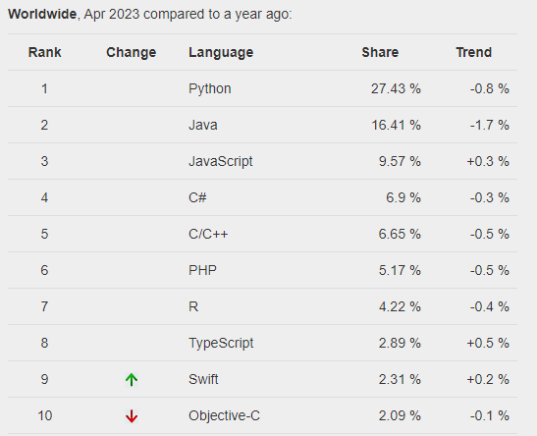
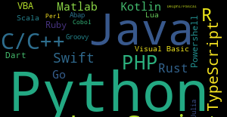
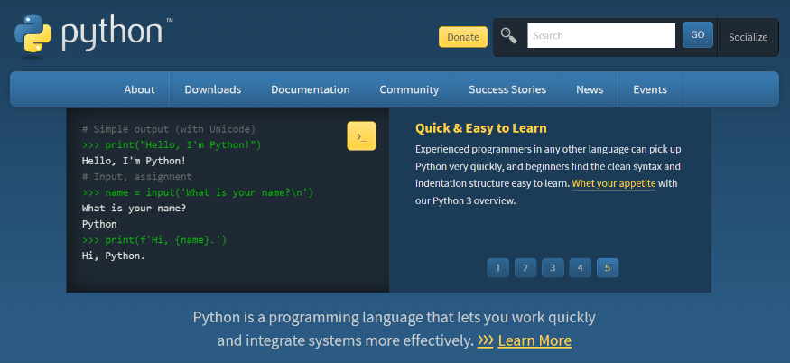
PYPL PopularitY of Programming Language
Worldwide, Python is the most popular language, Python grew the most in the last 5 years (6.0%) and Java lost the most (-5.4%)
The PYPL PopularitY of Programming Language Index is created by analyzing how often language tutorials are searched on Google.
The more a language tutorial is searched, the more popular the language is assumed to be. It is a leading indicator. The raw data comes from Google Trends.
If you believe in collective wisdom, the PYPL Popularity of Programming Language index can help you decide which language to study, or which one to use in a new software project.

Slide 4
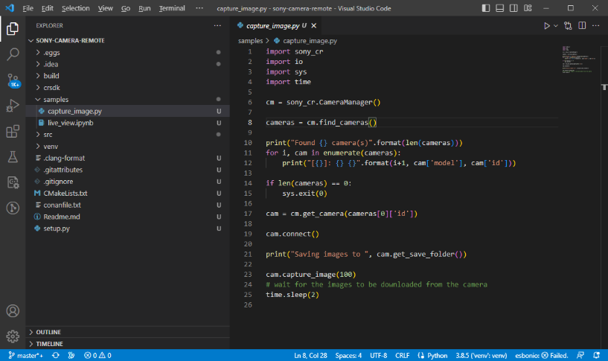
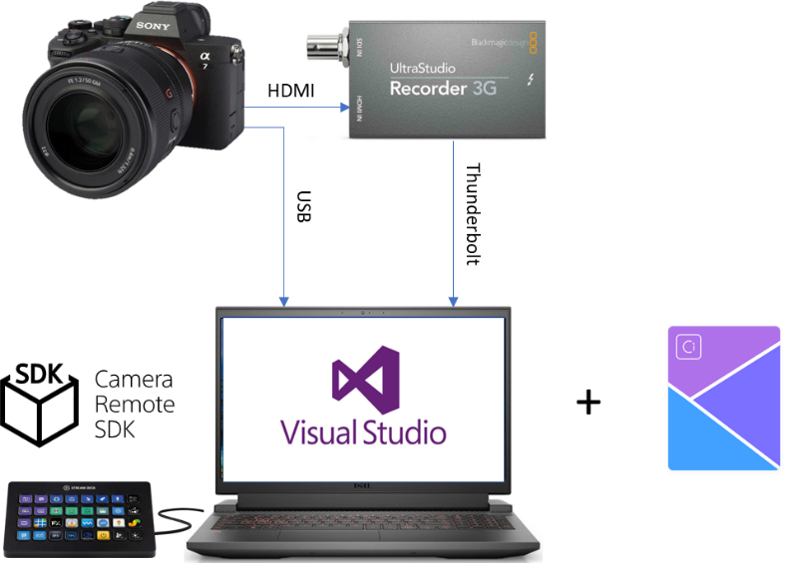

Python wrapper
Python wrapper
Demo at IBC2023
Explanation
It demonstrates several kinds of remote camera setting changes and functions control with showing build/debug environment together with python wrapper source code. Also it will capture HDMI output
and upload into Ci media
cloud automatically.
Python is one of the most
popular and easy languages
for application developer
and now it is available
for Sony Official Camera
Remote SDK
as it is developed
by Sony EPE members.

Slide 5



Interview Room
Demo at IBC2023
Front View
ILCE-
Side View
Explanation
It imitates reality TV show
like “Germany's Next Topmodel” and aim to show how easy to set up automatic confession box for production companies.
Not only camera recording
but lights will be automatically controlled on and off
by sensing visitor coming in,
sitting, and start confessing.
At the end, recorded contents
will be uploaded into Ci media
cloud automatically.
“Less man power” and
“Quicker contents uploaded”
are benefits to appeal.
Display x2
Main Light
Sub Light
70cm
Side
Top View
150cm
70cm
70cm
~200cm
Sub Light
~200cm
Main Light
25cm

